Slide 1


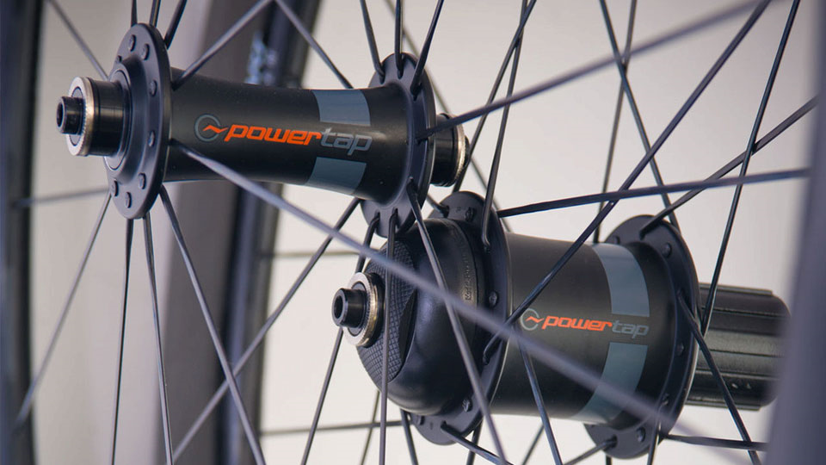
Powertap
User Guide

Slide 2
Power on
Ride the bike slowly to turn on the Powertap Hub in the wheel itself which will then automatically sync with the mounted display

Slide 3
Manual Zero
Before you get started you need to perform a manual zero calibration to ensure the greatest accuracy from the device
Firstly ensure that the Joule GPS handlebar mount display is on and quickly spin the rear wheel on the bike to activate/wake up the sensors, allow the wheel to stop moving
Then press and hold the top right button for 3 seconds on the joule GPS, use the +/- buttons to scroll up and down the menu, select sensors by pressing the top right button (enter/select)
Press enter again and choose powertap. Press enter
Press the – (minus) button to choose edit.
Scroll down to where it says power1, press enter, select power1 and press enter, press – to edit.
Scroll to the bottom of this menu and select manual zero
It will automatically search and a calibration value of between 500-524lbs should be displayed
Press the big button on the front to go back through the menu’s

Slide 4
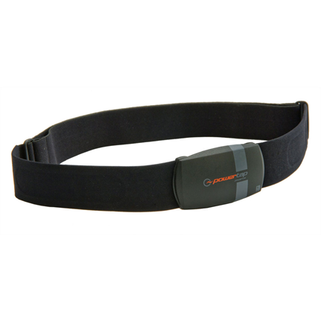
Heart Rate Monitor
Heart rate can also be recorded using the Powertap heart rate belt
Ensure that the electrodes are dampened with water before wearing for best pick up

Slide 5
Starting a Test
Go back to the display screen where the parameters (speed, distance, power etc) are displayed and simply get your subject to start cycling when ready.
If you have a false start and need to zero all the data, Press and hold the enter button for 3 seconds, select ride and press enter, then press stop and delete
Then go back to the menu
NOTE: A turn off GPS message may appear, press the correct button for yes

Slide 6
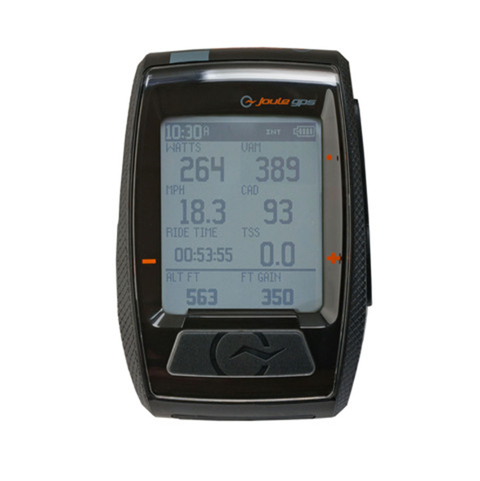
Recording a ride
Once the subject begins riding the timer will start and the power, speed etc will be displayed and recorded automatically
To stop press the button just under the display
Press and hold the enter button for 3 seconds, select ride and press enter, then press stop and save
‘Ride ended data saved’ should then appear and this will be ready for downloading onto the PowerAgent software

Slide 7
Add New User
Select File, then new, then Add New User

Slide 8
Add New User
Fill in name, weight, height, birth date and gender
Click next and unless required leave training zones with the figures they currently have
Click next again and unless required leave heart rate threshold as it is
Click finish

Slide 9
Downloading data
Connect the display unit to the PC using the USB cable
Select the symbol that looks like two monitors
A box will appear with the time and date of the data recorded. Select the one you want and press save
After you do this the data is automatically cleared from the display unit but will remain on the software unless deleted

Slide 10
Exporting Data
Once downloaded, click the activities tab on the left
This will display a list of recorded rides
Choose the corresponding ride and double click to open
A display will appear on the right hand side
To export go to file, export, activity data
A save box will appear, name as required and save. All data is saved into excel

