Slide 1
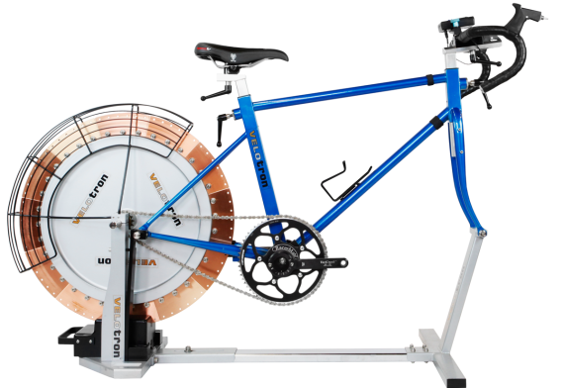
Velotron
User Guide

Slide 2
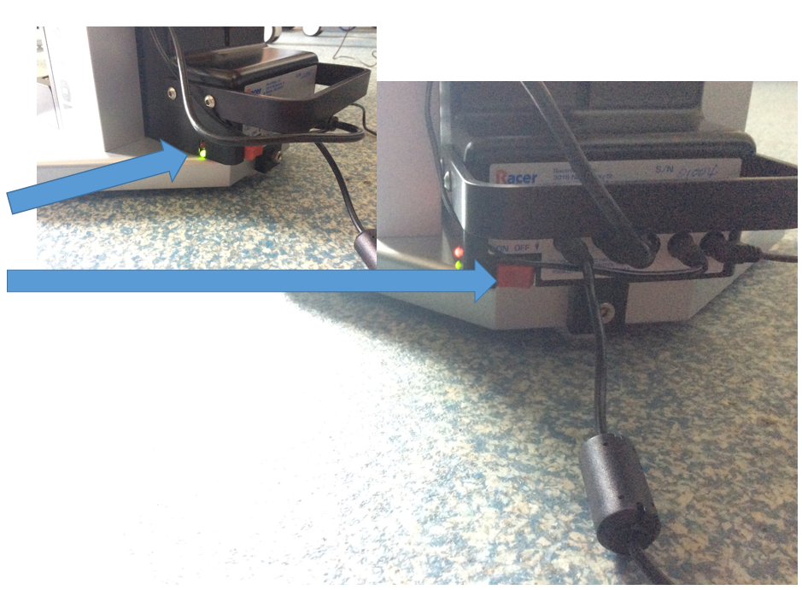
Power On
Switch on at the wall first. You should see a green light appear on the box underneath the flywheel
Secondly switch on the box underneath the flywheel (ensure that the flywheel is not spinning when you do this). A red light will illuminate above the green light to indicate that it is now powered on

Slide 3
Software
From the desktop open Velotron 3D 2008
Then select setup options from the two options available

Slide 4
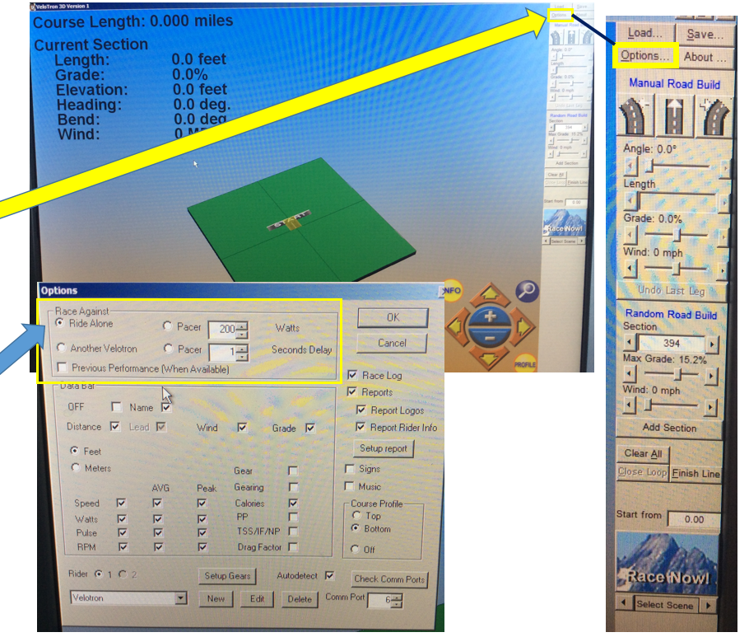
Course setup
To create your own course, first select options from the side bar on the right on the screen
Under the Race Against section, ensure that Ride Alone is selected

Slide 5
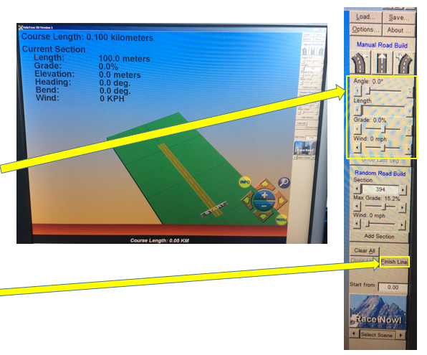
Course setup
To add sections click on the road icons
When you click on it for the first time, you will then be able to adjust the length of each section, the grade (incline/decline – this will make it seem harder or easier on the bike when riding these sections as if going up or down hill). 0% is the equivalent of riding on the flat
You will see the course length increase as you add more sections to the course
Once you have reached the required course length, click finish line

Slide 6
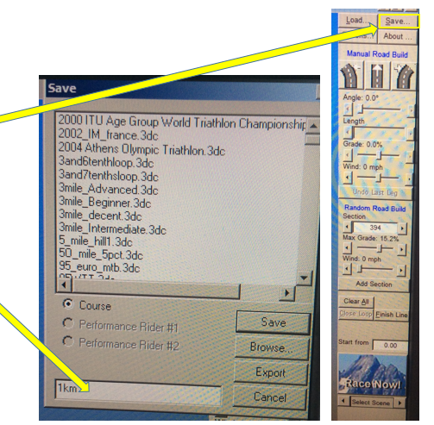
Save/Load Course
Then save your created course
Give it a name in the white box at the bottom and then click save
You can open previously created courses by clicking load from the top of the right hand toolbar. Then open from the list provided. You don’t need to create a new course every time.

Slide 7
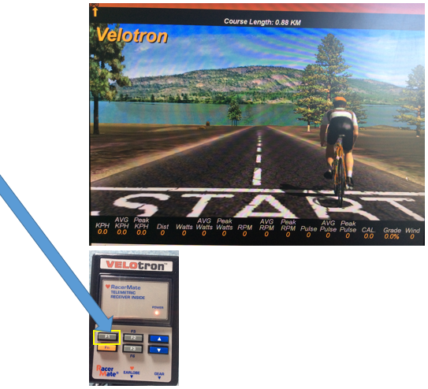
Run the test
Once you are ready to start the test, press F1 on the Velotron box mounted on the handlebars of the bike
A 3,2,1, Go! Countdown will appear on the screen then the test will begin recording on go.

Slide 8
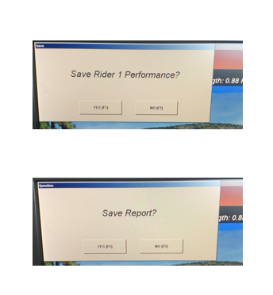
End of the test
The test will automatically end once the subject crosses the finish line
A box will pop up asking ‘Save rider 1 performance?’ Click ‘yes’
This will then be immediately followed by another asking ‘Save Report?’ Click ‘yes’
Close the Velotron 3D software

Slide 9
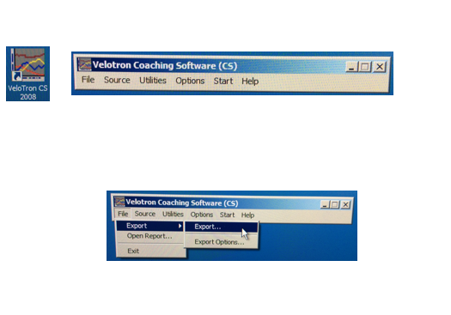
Data Exporting
From the desktop open VeloTron CS 2008
Click File – Export – Export…

Slide 10
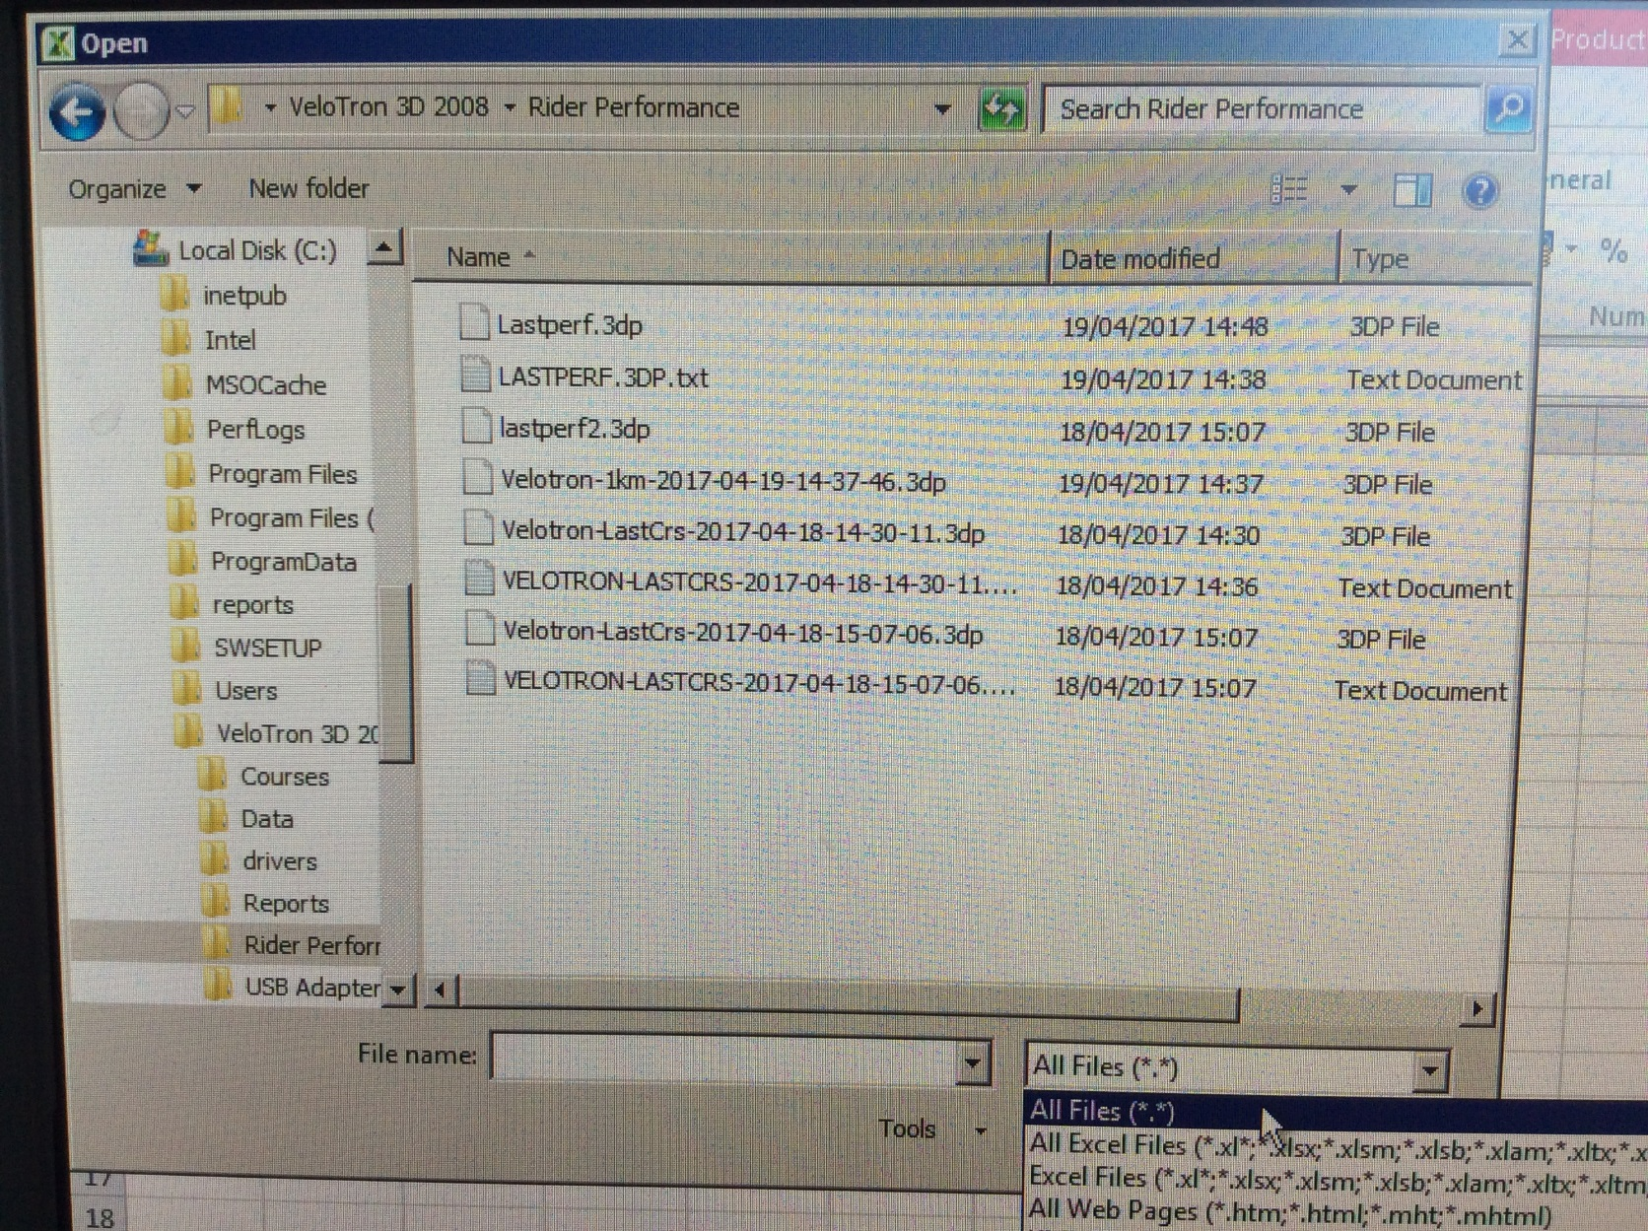
Data Exporting
Select Computer – Local Disk (C:) – Open the folder named: Velotron 3D 2008 – Rider Performance
Change the file type to All Files (*.*) and select the file called LASTPERF.3DP.txt with the date that you conducted the test

Slide 11
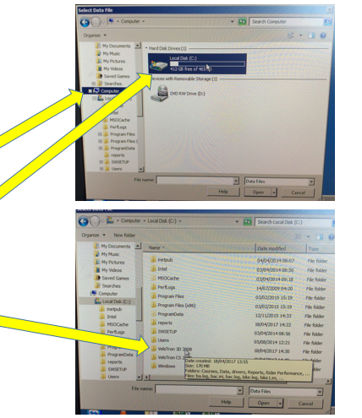
View test data
Open Microsoft Excel
Click open from the menu in Excel
Select Computer, then double click on Local Disk
Open the folder called Velotron 3D 2008

Slide 12
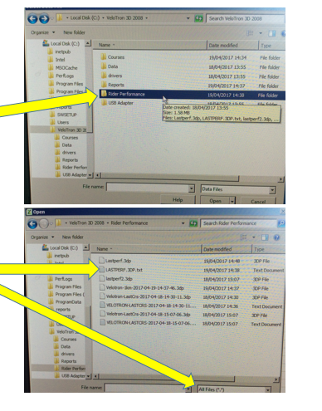
View test data
Open the folder called ‘Rider performance’
Ensure that next to file name, ‘All files’ is selected
Then select the text document e.g. LASTPERF.3DP.txt
The text files are time stamped and dated so your data will be the most recent time/date

Slide 13
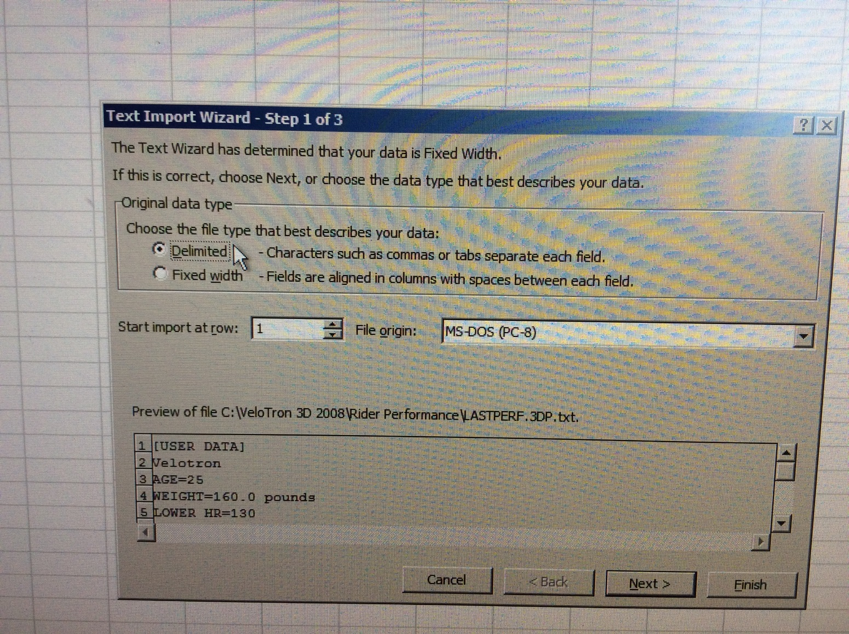
Excel Step 1
Once the file has been opened the text import wizard will open.
Select delimited
Click next

Slide 14
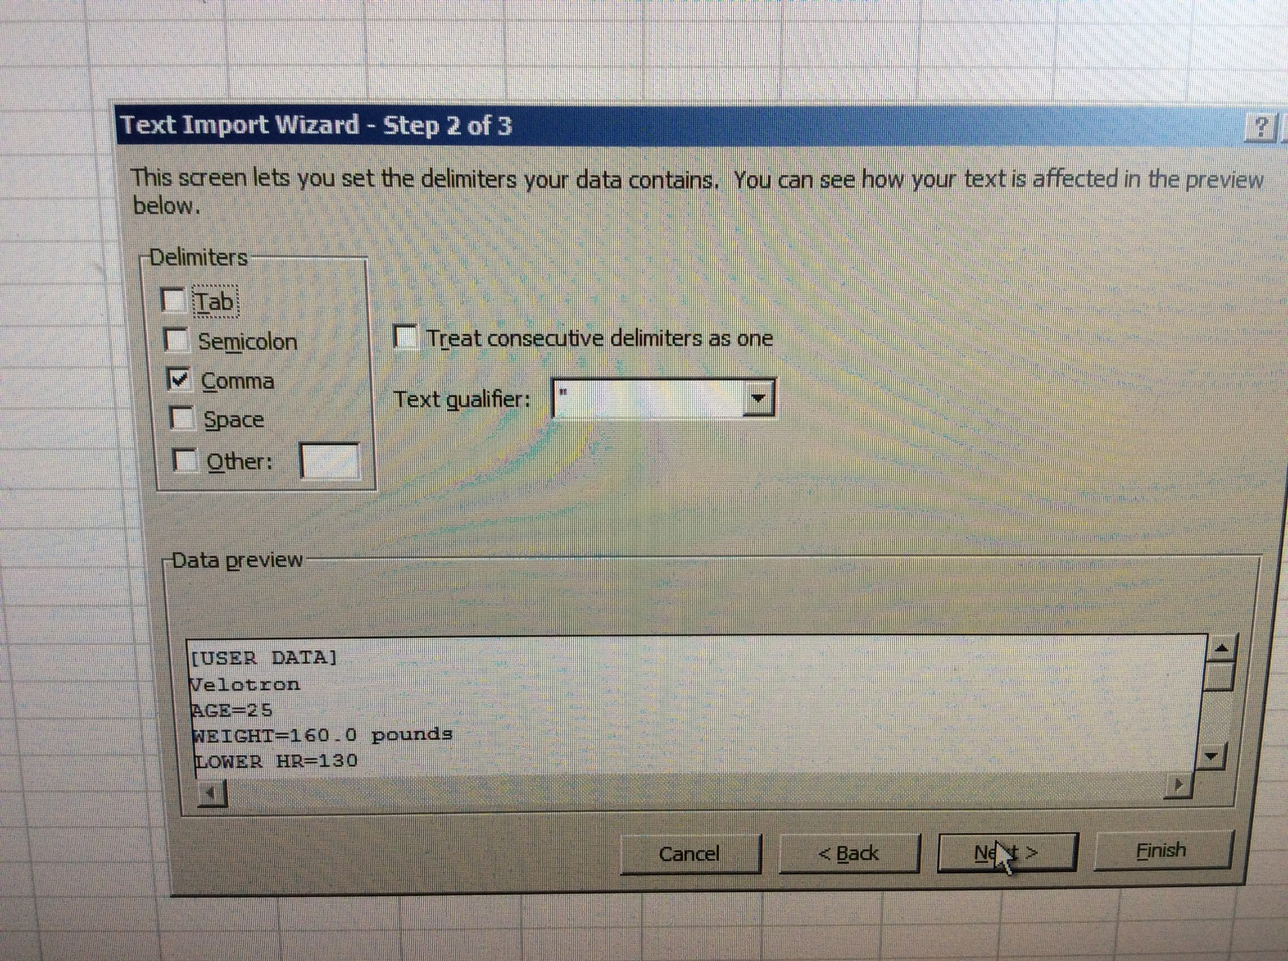
Excel Step 2
In the next window, deselect tab and choose comma in the delimiters area
Click next, then finish
Your data will appear

Slide 15
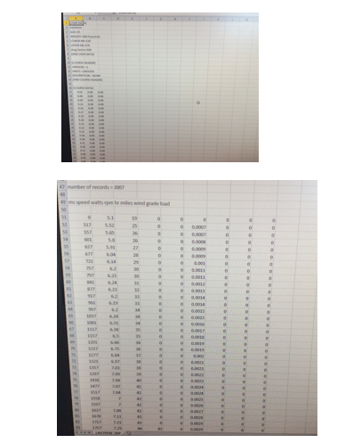
Test data
The data will then open in Excel
Scroll down and you will see a long list of data points
The headings won’t match up exactly with the data columns but this is something that can be easily fixed by manually typing them in

Slide 16
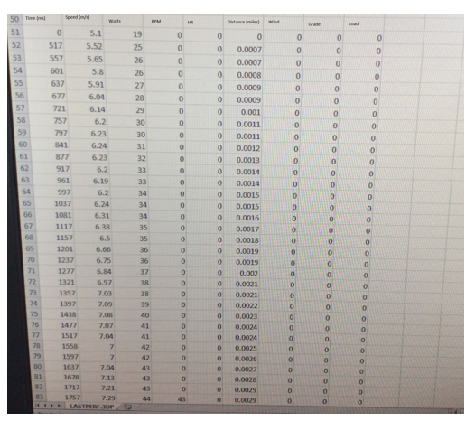
Test data
The columns show the data as:
Time (milliseconds)
Speed (metres per second)
Watts
RPM
HR
Distance (Miles)
Wind
Grade
Load

Slide 17
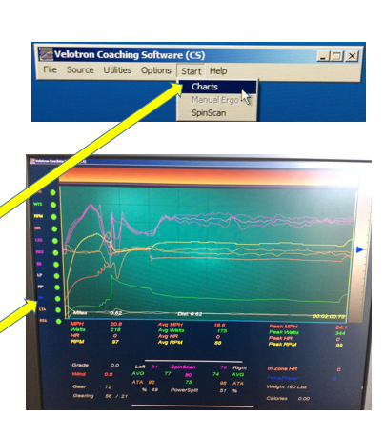
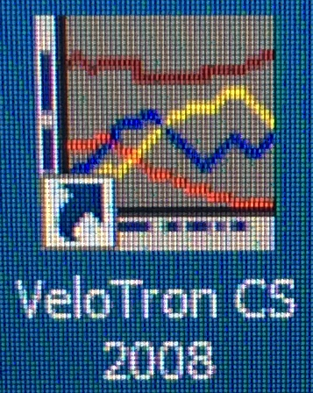
Additional Data
Should you wish to see data traces for the time trial, such as watts, speed etc, you view this using the Velotron CS 2008 software
Once opened, go to start, then click on charts
It will then show the screen on the right

